Slide 1
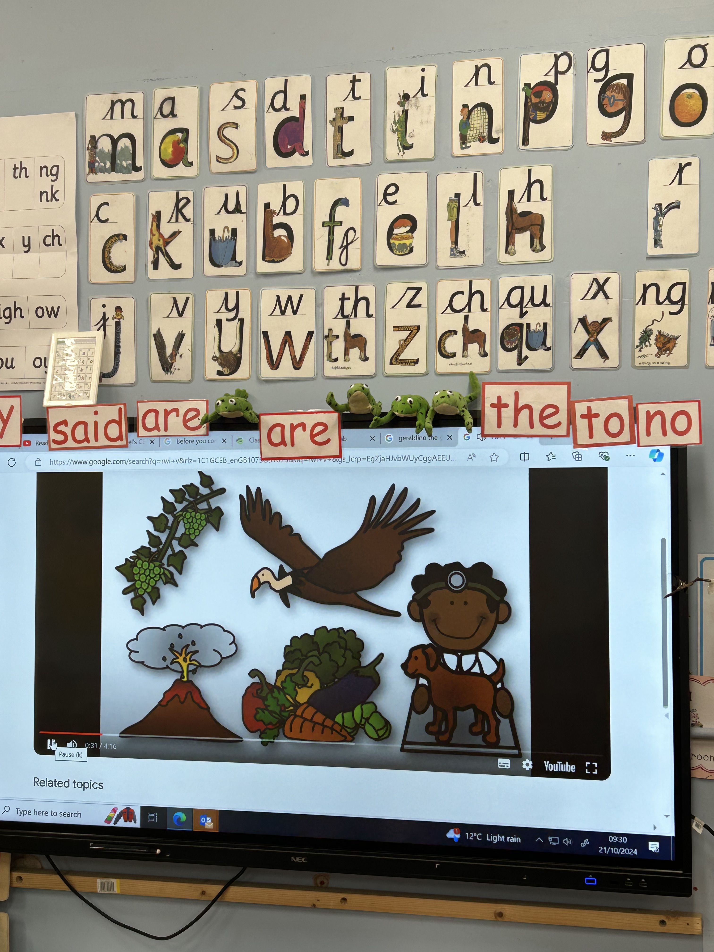
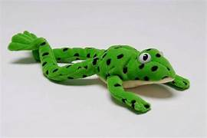
Phonics at St Michael’s
.
Information for parents.

Slide 2
Read Write Inc.
Read Write Inc (RWI) is a phonics programme which helps all children learn to read fluently so they can focus on developing their skills in comprehension, vocabulary and spelling. It also allows them to spell effortlessly so that they can put all their energy into composing what they write. Mixed group phonics lessons are taught daily by staff and there are consistent expectations across the range of abilities. Towards the end of each term or when thought necessary the children are assessed to check on their progress.
Children start in Reception by learning letter sounds which help them to read and write. They then practise reading skills through reading 'Book Bag Books’ and their phonics stage book in school and at home which are specifically pitched to both consolidate learning and provide challenge in an engaging and fun way!

Slide 3
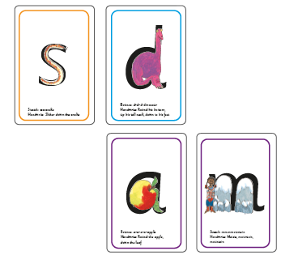
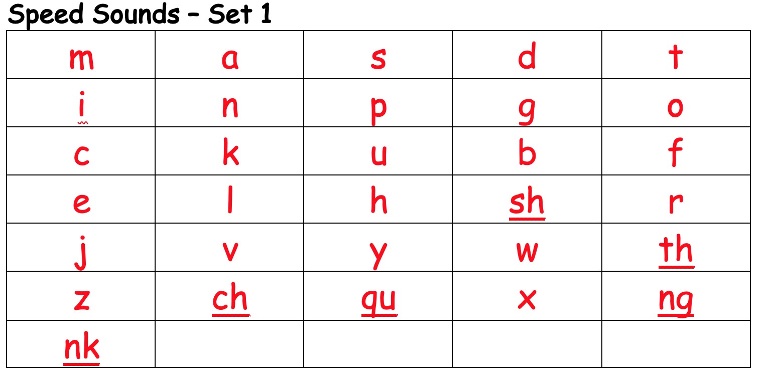
EYFS, Y1 & Y2. learning to read
Children are taught the early sounds in Set 1. This covers the alphabet and a few ‘special friends’ (digraphs) which are two letters which make one sound such as ‘sh’. They will learn to spot and recognise them quickly through fun activities and also write them using ‘phrases’ to help them remember the correct formation. We teach children ‘pure sounds’.
https://www.youtube.com/watch?v=yln6PpV1G1I

Slide 4
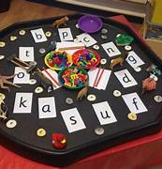
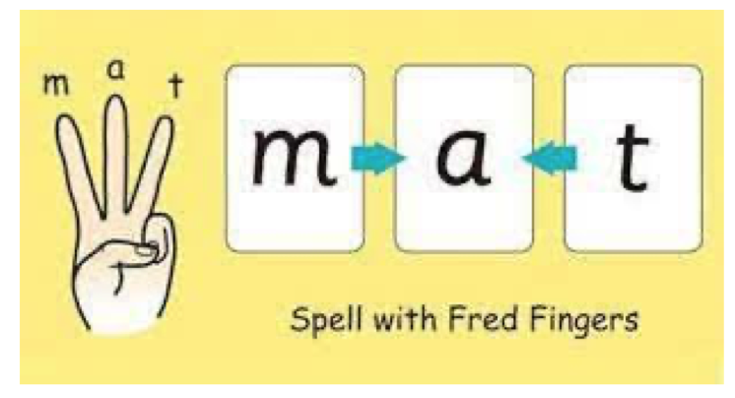
EYFS, Y1 & Y2. Learning to read
Using the set 1 sounds, children will learn to ‘blend’ words together so c-a-t becomes cat. To help the children do this, we have a green frog called Fred! He can only talk in sounds so the children put the sounds together to make the word. We call this ‘Fred Talk’. This is also used in early reading, as when children see a new word they can use ‘Fred Talk’ to break down the sounds and then say or read the word. Similarly, this supports early writing skills as children use ‘Fred Fingers’ to break down a spoken word into its sounds to enable them to write the word. We use the phrase ‘Say the word – pinch the sounds’ to help children remember.

Slide 5
EYFS, Y1 & Y2. Speed Sounds
When children are confident with blending and know all of the Set 1 sounds, they will move onto Set 2 sounds and then Set 3 sounds, which introduce alternative spellings for sounds they know and more special friends.
They may begin to use ‘Fred in their head’ to read more quickly and fluently, which helps to build up speed, however this stage is also tricky for children as they need to be able to spot ‘special friends’ easily within new words.

Slide 6
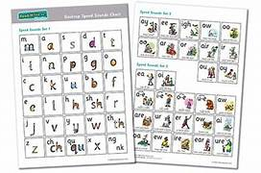
Speed Sound Charts

Slide 7
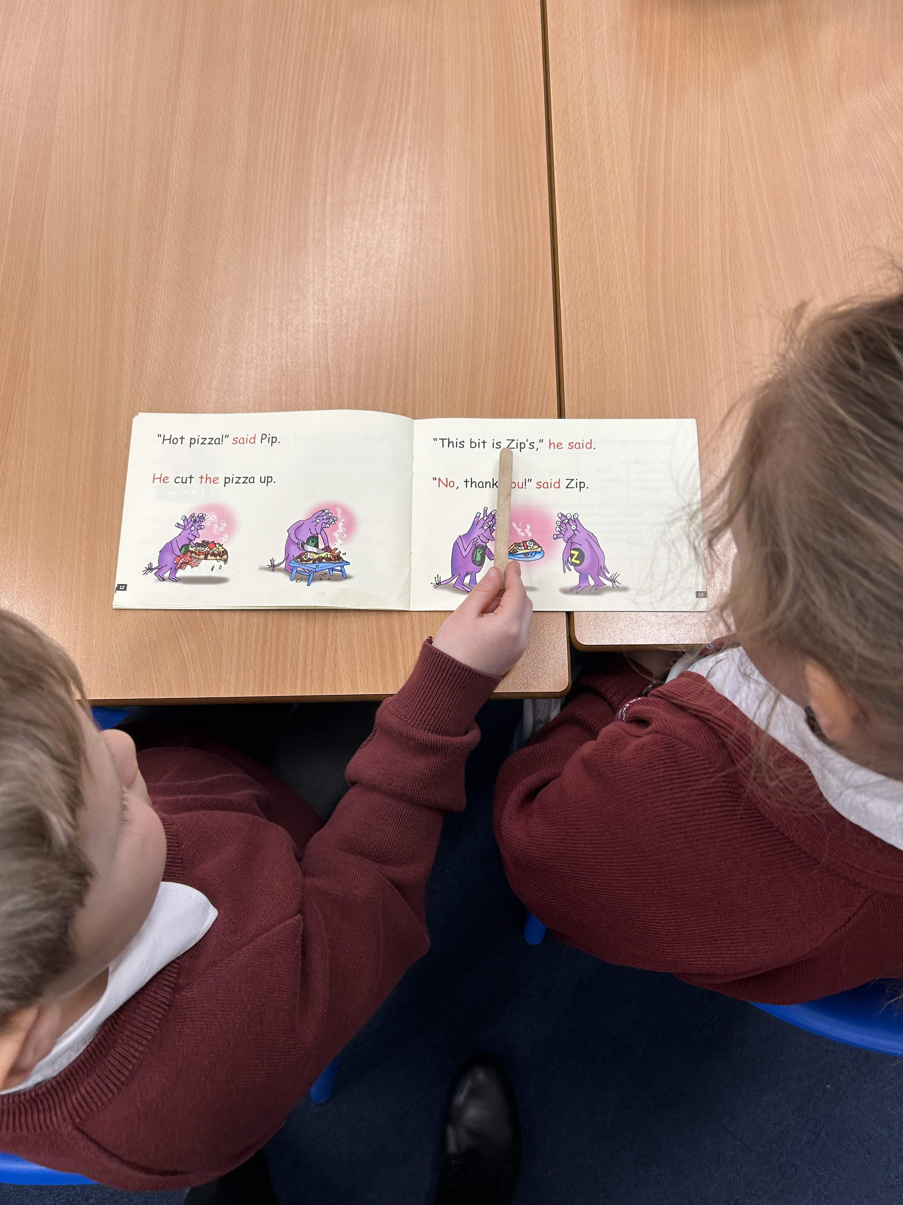
Rwi Daily sessions
.Speed sounds warm up using class sound chart / sound cards. Revise some red words & green words.
.Introduce new sounds & words.
.Whole group reading – intro. new text/reread text. .Paired reading – children take turns to read to each other. One child points to words whilst their partner reads. Children are encouraged to support each other.
.Get Writing task – Hold a sentence/correct the sentence/complete a sentence/construct sentences.
Think, Say, Write, Read.
.Sound card games revising learnt sounds.

Slide 8
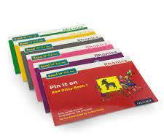
By moving through the carefully designed stages (or colours) of books which consolidate the sounds learned at the right time, children will gain speed and confidence in their reading ability. As reading becomes more fluent, children begin to understand the stories they read and can enjoy the books. As part of the RWI sessions they will read their group books many times; to support learning new speedy green words and more tricky red words, to investigate vocabulary and to build expression known as their ‘storyteller voice’.

Slide 9
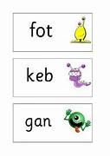
Green words & red words
Words which can be decoded are called ‘Green Words’ as they can be deciphered using phonics knowledge. Unfortunately, there are lots of words in the English language that do not follow these rules ... they are called ‘Red Words’ or tricky words and need to be learnt by sight. We use the phrase ‘If it’s red - it’s hard to Fred’ to remind children.
When faced with an unfamiliar word we use the phrase ‘Special friends – Fred talk – Read the word’ as this reminds them that it is important to spot the special friends before attempting to read the word. To further consolidate this we also use ‘Alien Words’ which are made up words that do not make sense. These words test to see if the children can spot any special friends and that they have good sound knowledge, rather than recognising familiar (or sense) words and using memory rather than reading skills. This technique is also used in the National Year 1 Phonics Check, which takes place in the Summer Term.

Slide 10
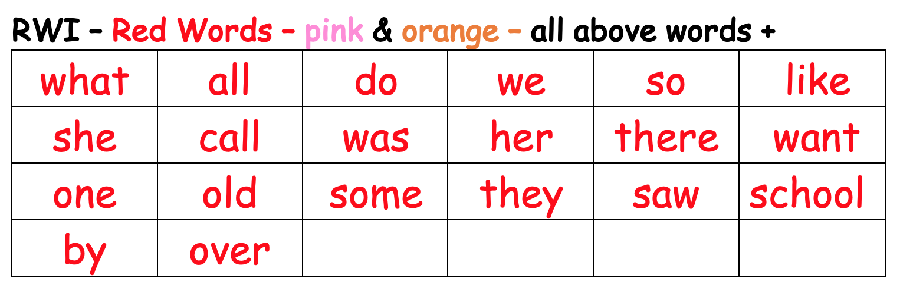
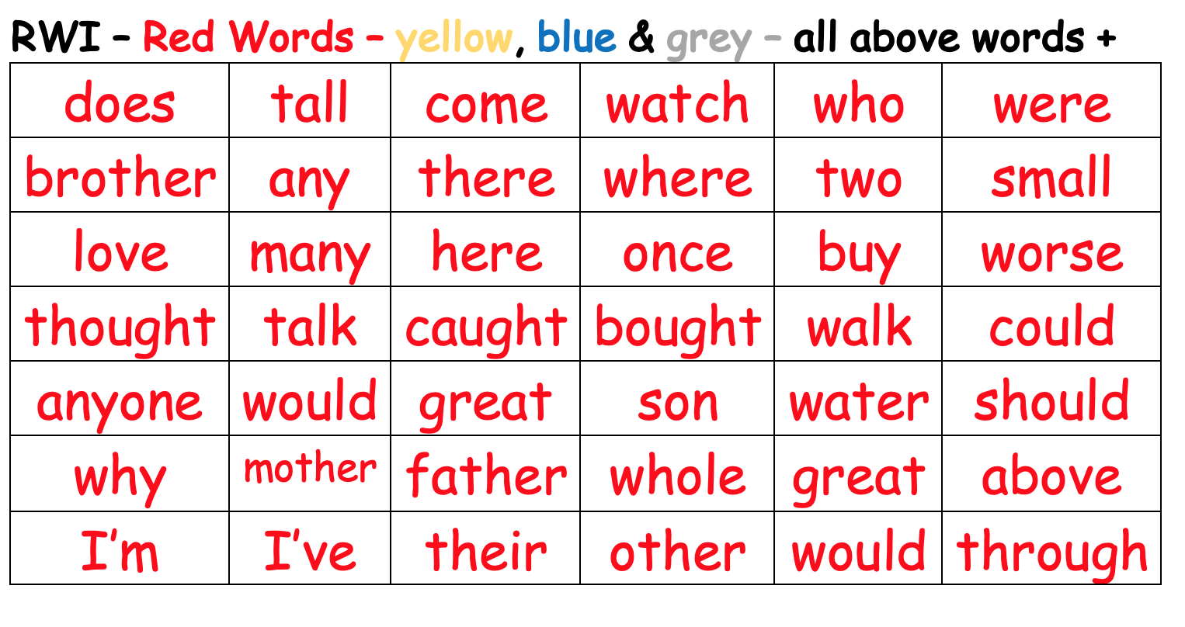
RED WORDS
Red words are introduced as children progress through the different RWI stages/colours.

Slide 11
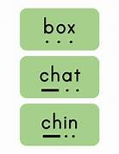
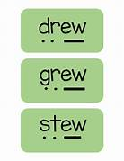
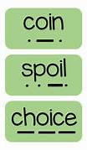
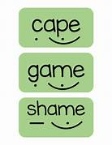
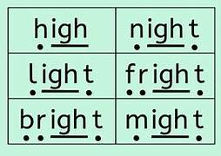
Green Words
Once the children have built up a secure phonic knowledge & understanding green words can be decoded and read with ease. Children quickly spot special friends (digraphs & trigraphs) in words before they read them.
Class spellings are linked to phonics sounds being covered in class.
Special friends - Fred talk - Read the word

Slide 12
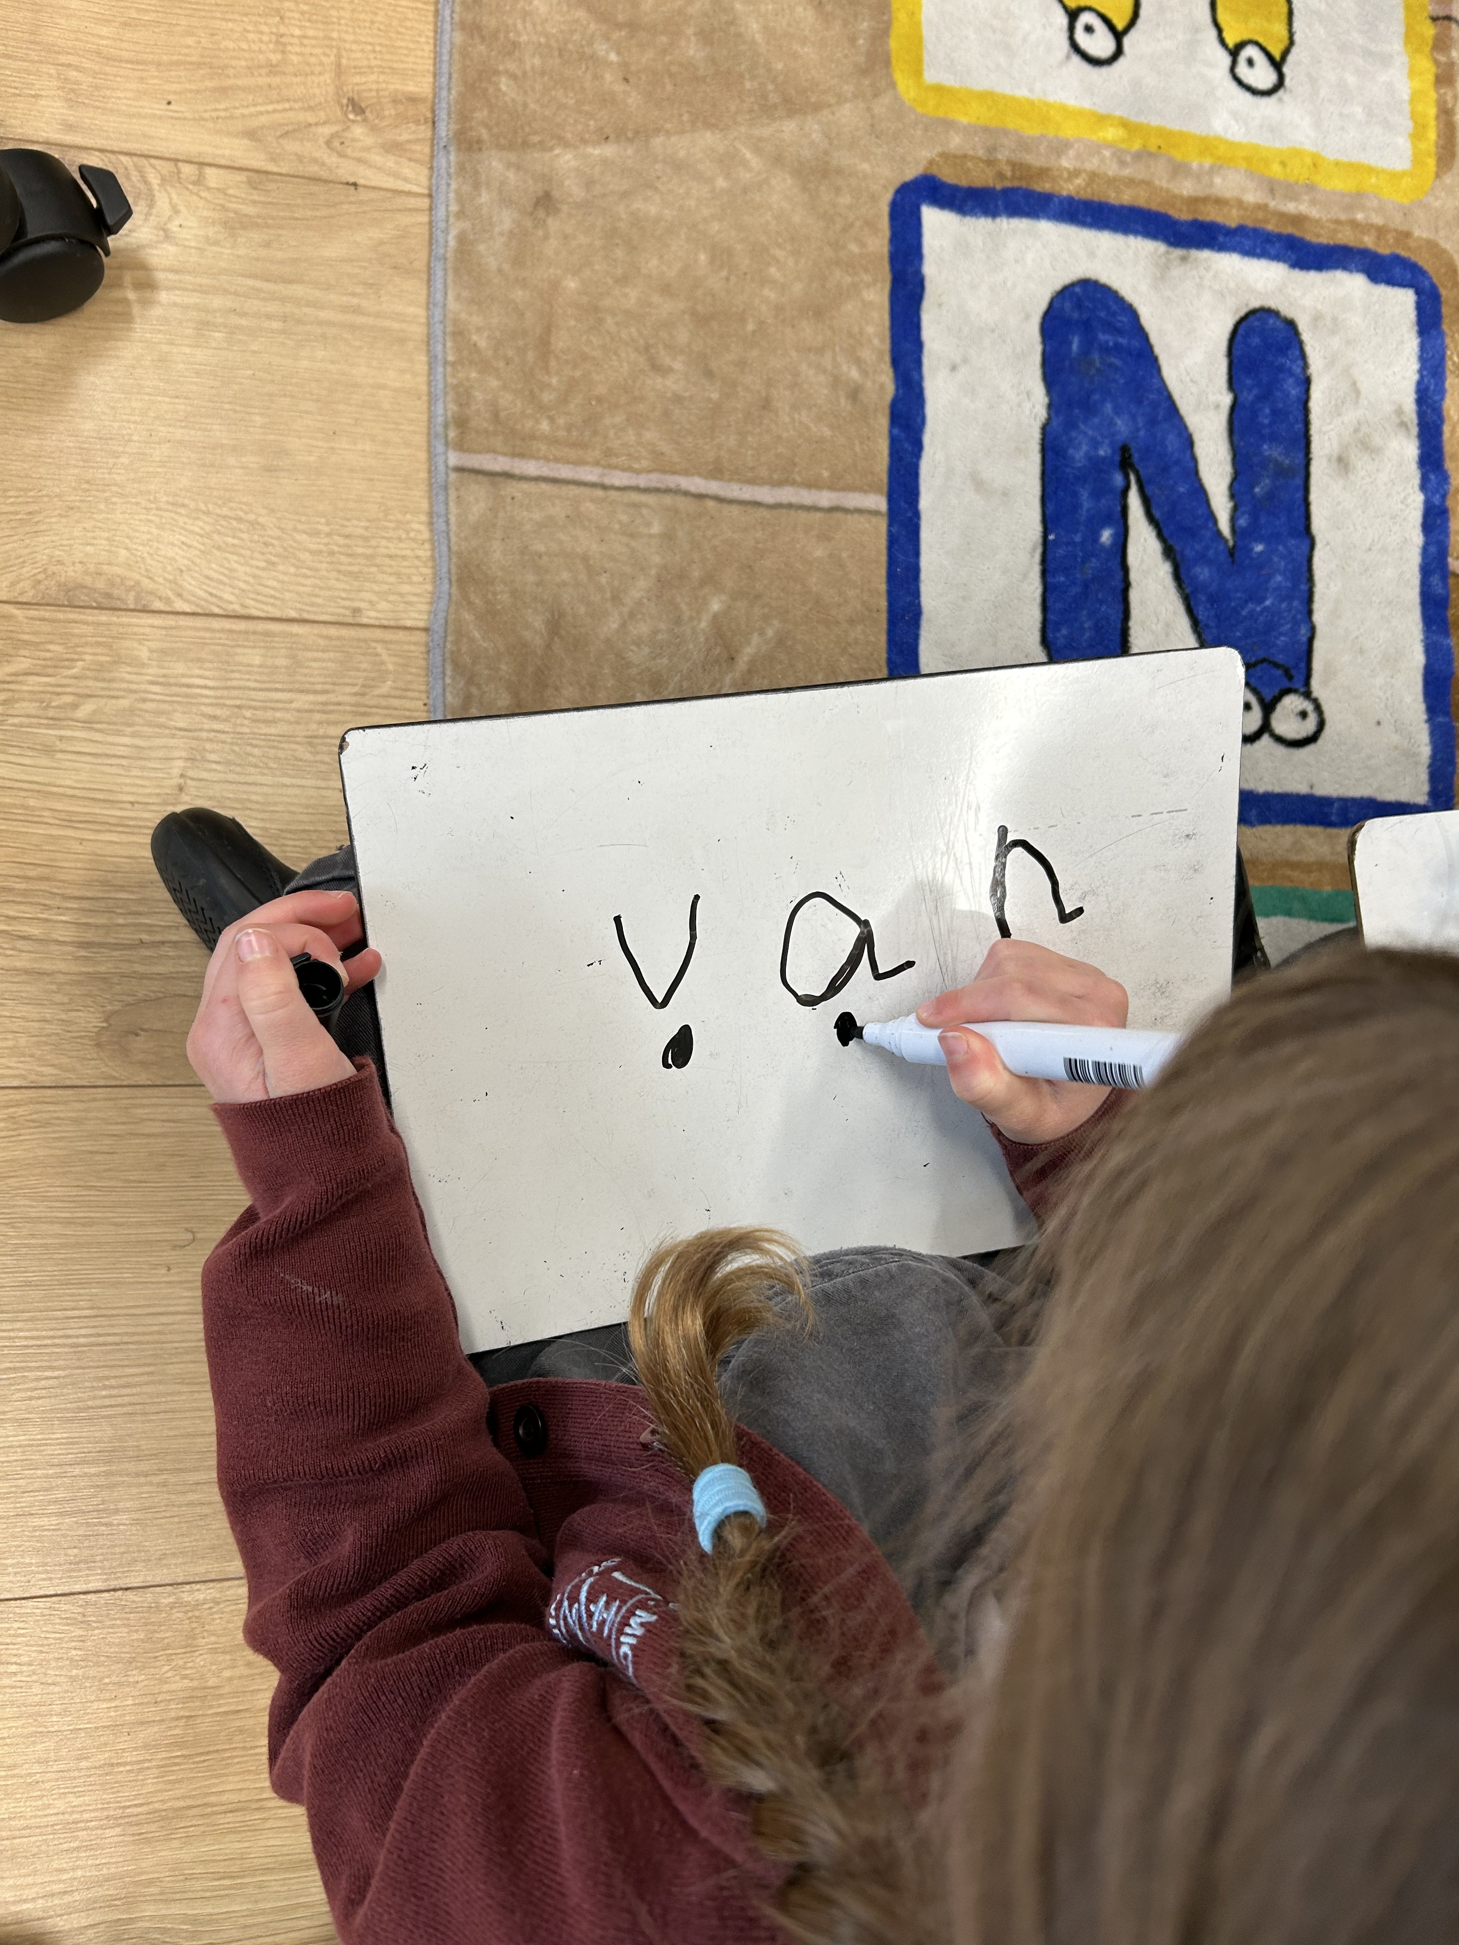
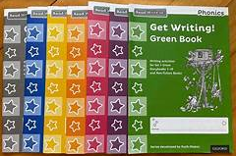
GET WRITING
Part of the RWI sessions include Get Writing tasks.
. Letter formation. . Sounding out and writing words.
. Hold a sentence (simple dictation)
. Correct a sentence (spelling/punctuation)
. Complete/construct sentences/clauses/captions.
Short writing tasks.
Writing tasks link to the fiction/non-fiction book the children are familiar with. For the early stages writing tasks are guided. As children move through the stages/colours and gain confidence the writing tasks become more independent.
All writing tasks encourage children to check their work and correct any mistakes made.

Slide 13
USING PHONICS IN ENGLISH LESSONS
After the daily RWI group session, children return to class for a literacy lesson. They explore many different writing activities, building up sentence structures and rehearsing ideas before writing. During this, they are encouraged to use the Sound charts to help them identify the correct spelling for a sound and will be taught various spelling strategies within their class to support spelling. They continue to work on letter formation and investigate grammar and punctuation rules appropriate for their year group. This will enable all children to practice and apply their individual phonics learning throughout the lessons and for class teachers to provide further input.

Slide 14
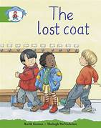
HOmE READING BOOKS
Books children take home:
. RWI Book Bag book.
. A copy of their RWI group reading book.
. A reading for pleasure book which is linked to their RWI stage.
. Children also have sound charts to use at home.
https://www.youtube.com/watch?v=07DruIKFsKw
_____________________________________
KS1 Children take part in 1-1 Reading, RWI paired reading, guided reading and whole class reading sessions on a regular basis.
Assessment
Regular RWI, Phonics screening & PM Benchmark assessments monitor progress, inform groupings and need for intervention where necessary.

Slide 15
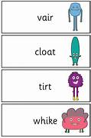
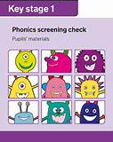
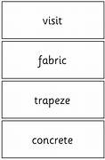
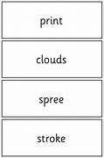
Y1 Phonics screening check
https://www.youtube.com/watch?v=4XtDTwfjXM4
https://assets.publishing.service.gov.uk/media/6495b5d783131100132962d0/2023_phonics_pupils_materials_standard.pdf

