Slide 1
Meet the teacher
Year 6
Miss Tracy

Slide 2
Y6 expectations
Preparation for secondary school
High expectations of behaviour and learning – following 6Rs, being good role models
Responsibilities around school – all children have these opportunities
More independence
Notes:
Alter as appropriate for your year group

Slide 3
Home learning
Children should be reading at home daily
It will be set on a Thursday and due in on the following Wednesday
Can access via Seesaw or school website
One piece of English (SPaG or reading comprehension), MyMaths, spellings (test will be on a Wednesday)
Brain builder – 1 per half term (timetable on school website)
Notes:
Alter as appropriate for your year group

Slide 4
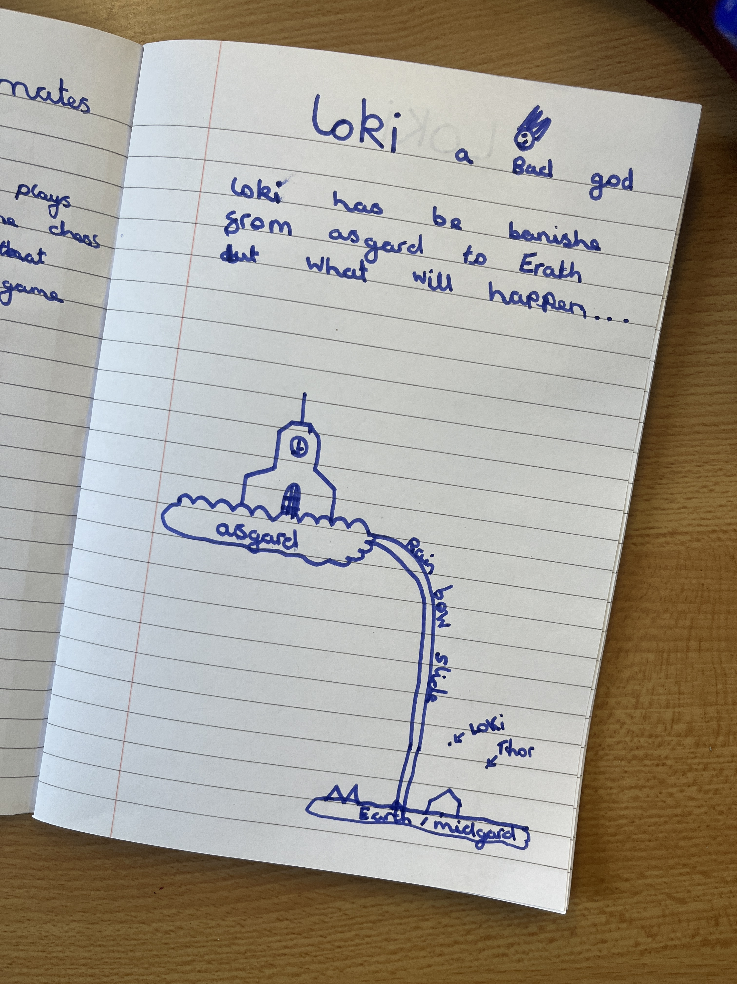
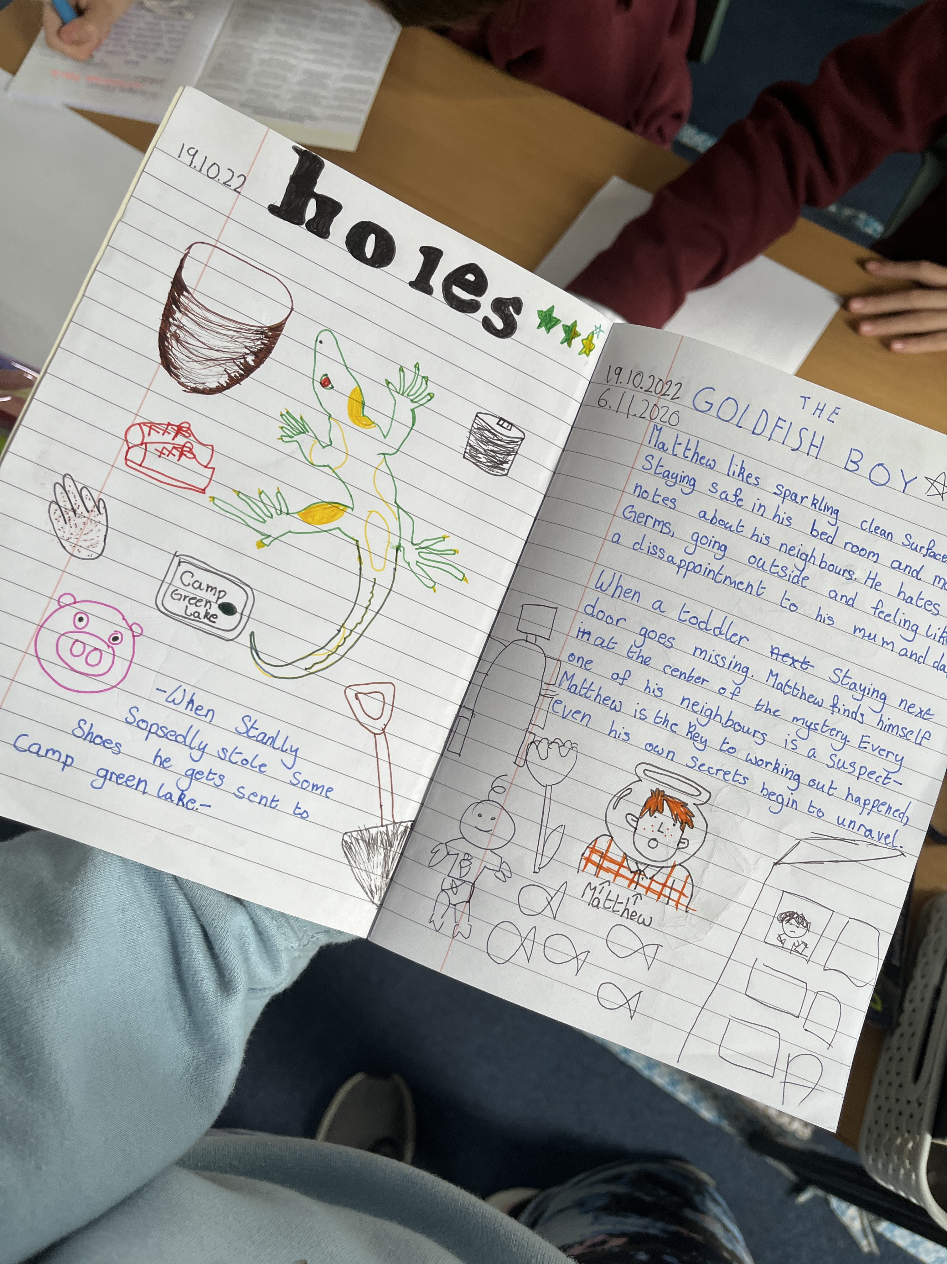
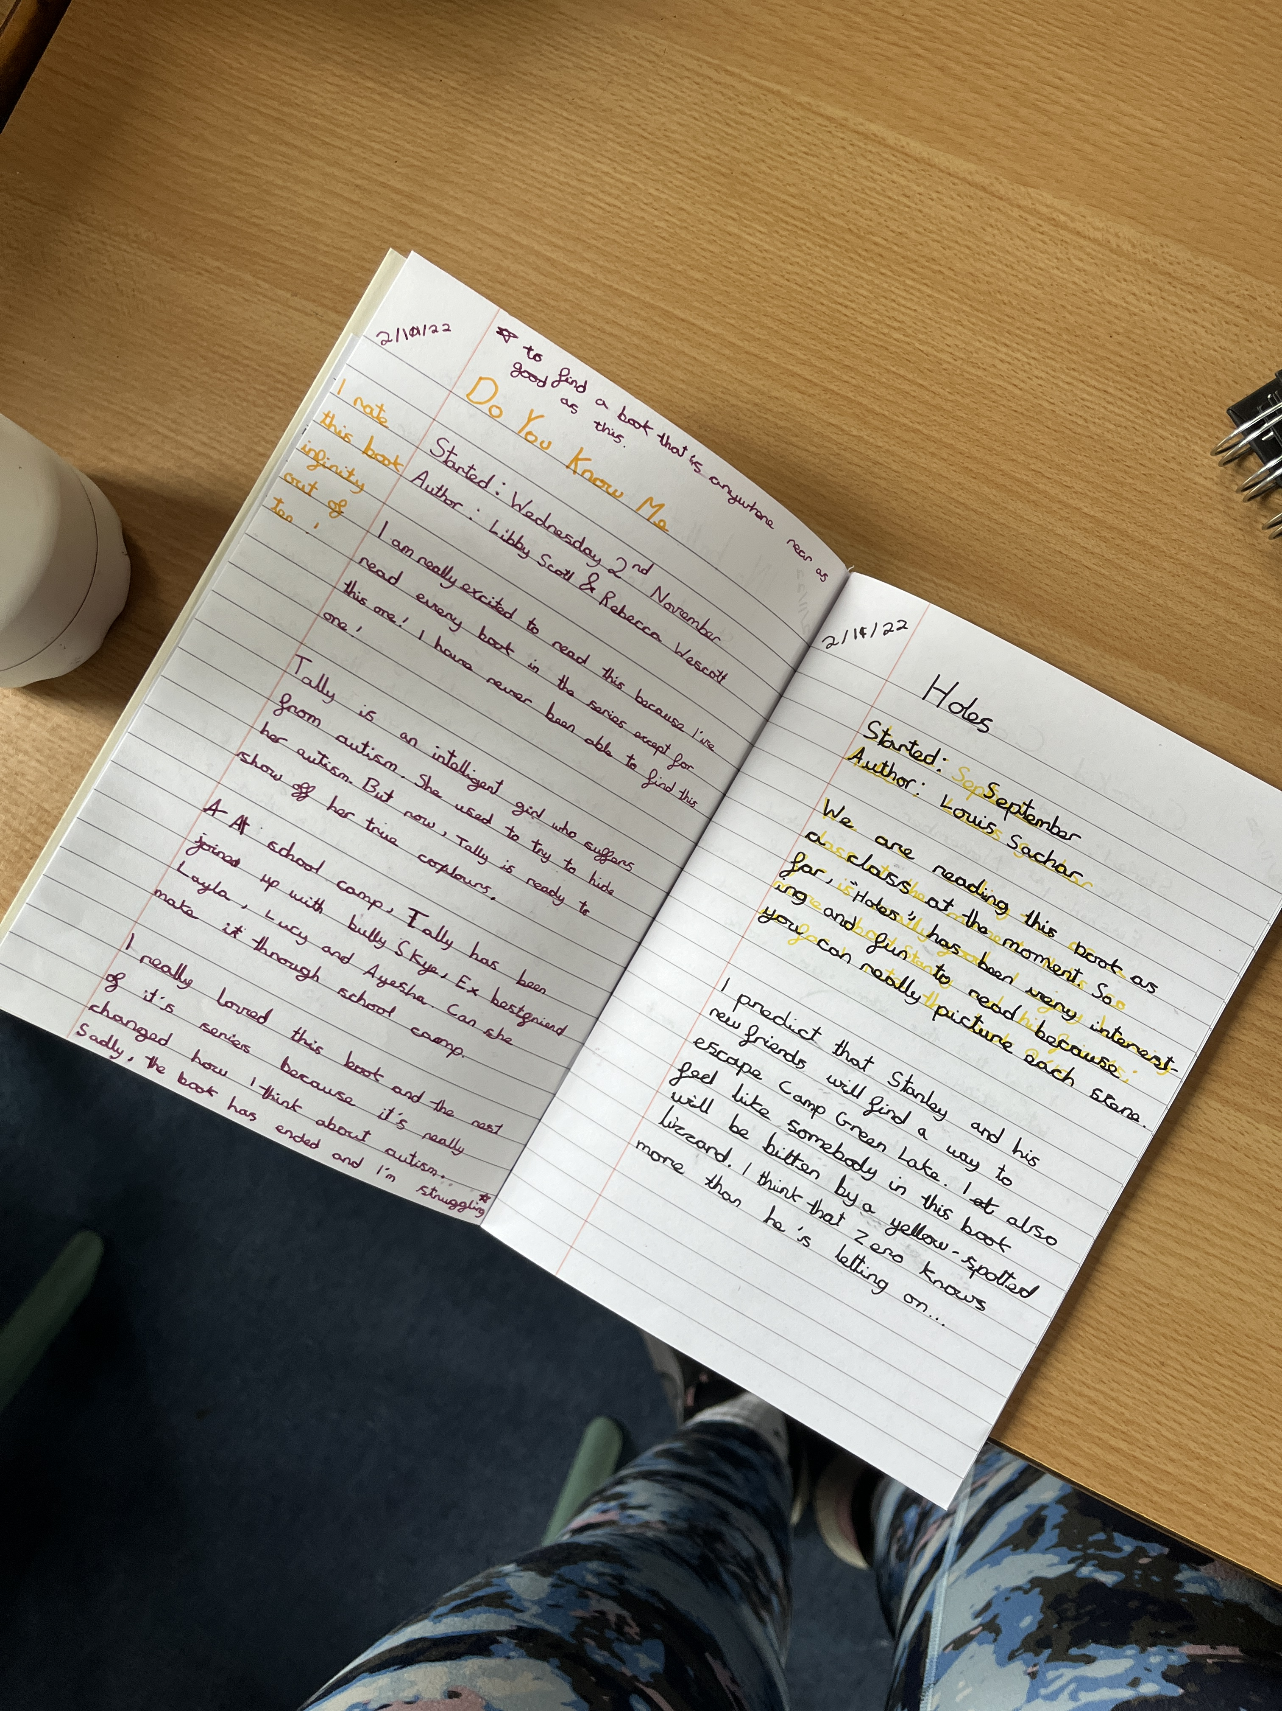
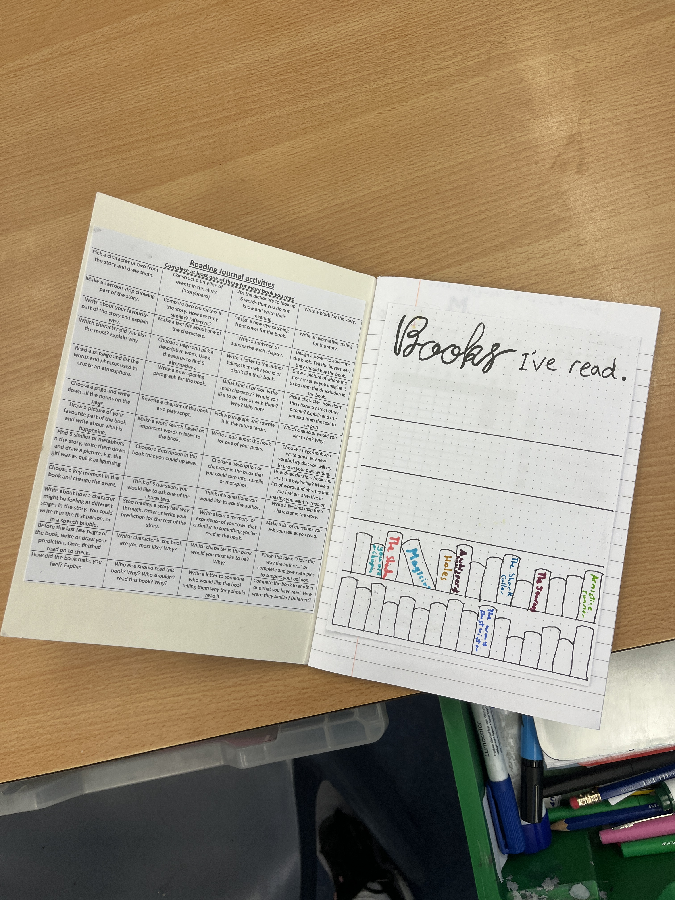
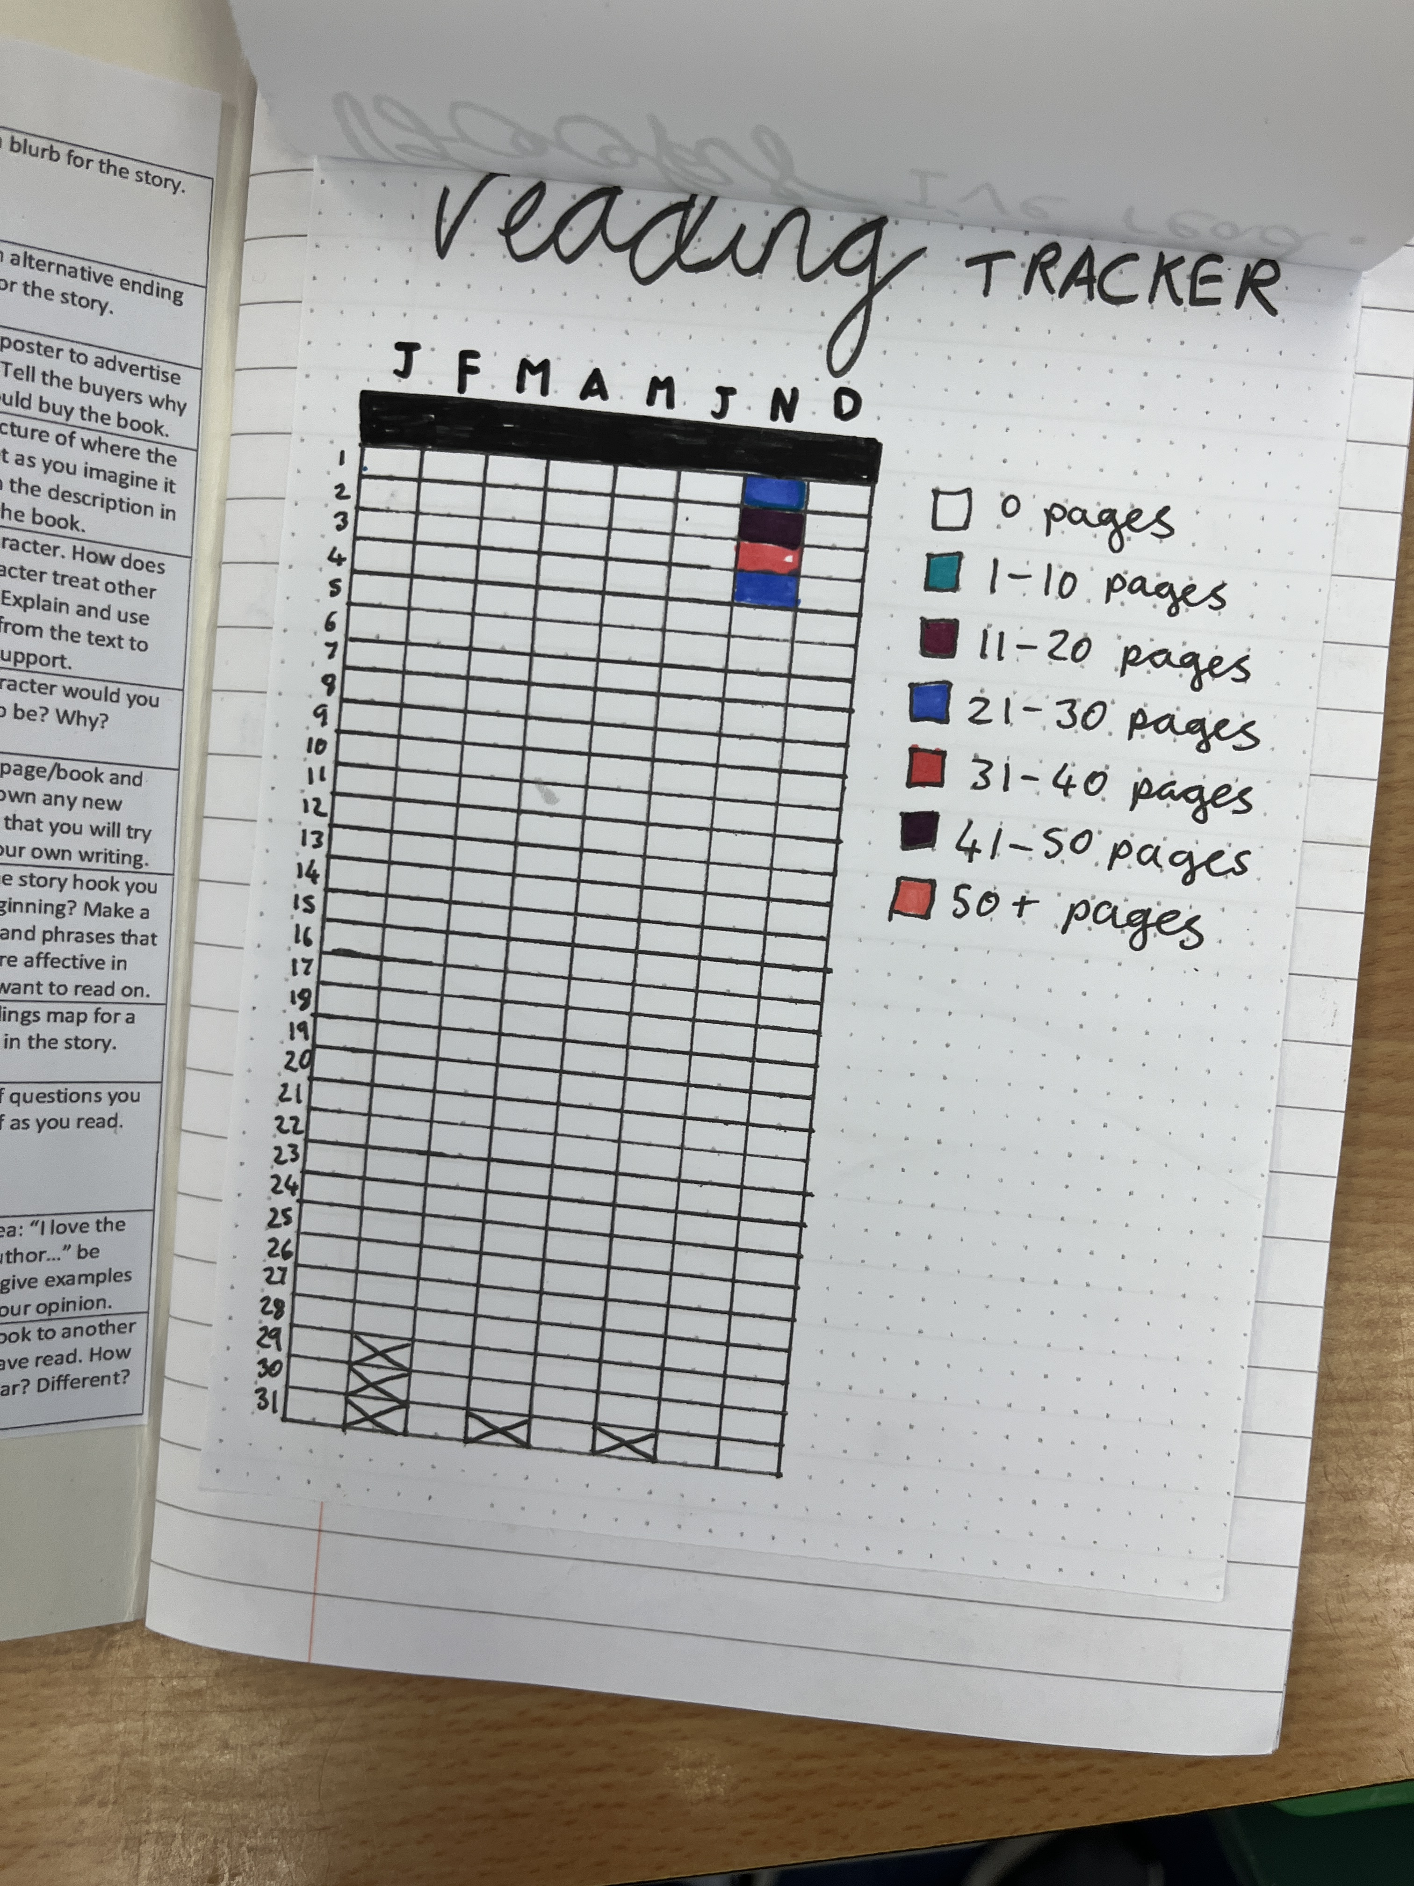
Reading journals
Y6 use reading journals rather than reading records
More independence and creativity
Give them time in school, but can complete at home if they like
Notes:
KS1, Y3 and 4 – reading record info

Slide 5
trips
Reading Museum November
British Film Institute January
Residential trip June
May be other local trips or a whole school trip at some point
Notes:
Alter as appropriate for your year group

Slide 6
timetable
PE Wednesdays and Fridays – come in in PE kit
Ukuleles on Tuesdays until Christmas
Generally, English and Maths in the mornings and other subjects in the afternoons
Gates open at 8.35 and it is important that children are in school as promptly as possible as we begin our learning during soft start
Notes:
Alter as appropriate for your year group

Slide 7
RSE
Relationships and sex education
Policy and coverage on school website
A letter will go home before we teach this as parents have the legal right to withdraw children if they would like
Notes:
Delete the withdrawal part for other year groups

Slide 8
KS2 SATs
13th – 16th May 2024
End of KS2 assessments Y6s across the country take to assess progress in KS2
GPS, Maths and reading. Writing is assessed by me and can be externally moderated
No extra work is needed at home – we prepare them throughout KS2 as they cover the curriculum
Will do a bit of extra practice in the spring/ summer term
No pressure!
Notes:
Alter as appropriate for your year group
Y1 – Phonics
Y4 - MTC

Slide 9
assessment
We carry out assessments in school at the end of Autumn, Spring and Summer Terms
We will report to parents after Christmas, after Easter and in the summer term
After Christmas and Easter, this will just be a printout of where your child is in relation to age-related expectations:
WTS – working towards the expected standard
EXS – working at the age-related expected standard
GDS – working at greater depth
In the summer term, this will be a full written report
Children start a new set of objectives each year, so they won’t necessarily be achieving EXS in the autumn – this doesn’t mean they aren’t on track for achieving EXS in the summer

Slide 10
Important dates
We try our best to keep these dates, but sometimes we have to make changes for reasons out of our control – this will always be communicated as early as we can
5th October: whole school flu immunisation
10th October: school photographs (individual)
18th October 9.30am: Harvest Service in church
10th November 10.45am: Remembrance Day service in playground
13th November 1-3pm: Y6 Ascot Racecourse visit
21st November 2-4.30: work viewing afternoon
30th November 1-3pm: Y6 to ‘Christmas Unwrapped’ at White Waltham Church in Maidenhead
1st December 10am: KS2 tree trimming
13th December 1.30pm: Church Christmas service
Tuesday 6th and Thursday 8th February: parent meetings
Thursday 7th March: World Book Day
27th March 1.30pm: Easter Church service
30th April 2-4.30pm: work viewing afternoon
13th-16th May: Y6 SATs
17th – 21st June: Y6 residential
11th July 9.30am: KS2 sports day
18th July 3.30pm – Year 6 play
24th July 9.30am – leavers’ service in church

Slide 11
other
See school website for any important info, including dates and this Power Point
Please contact me via the school office if you ever need to

Slide 12
THANK YOU

